Slide 1
Getting to Zero
Combining Solar Energy with
Biomass Fuels
To Save the
Forests and Watersheds

Slide 2
Fossil fuels are a thing of the Past
Fossil Fuels are just ancient Plants stored underground
Millions of year of Savings have been burned in less than 2 centuries
The planet’s energy balance has been disturbed
Climate change has been the result
Renewables are Now based Income Energy

Slide 3
The Sun Doesn’t Shine at Night
Kit Carson Electric is planning for 100% Solar for Summer Daytime Power
During the Winter the Total Load TRIPLES
Battery Storage will help
But Batteries are Expensive
Most of Winter Loads are Thermal

Slide 4
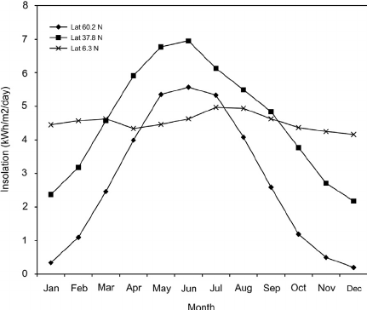
It’s a Matter of Timing
Solar Energy by Month
Propane Use by Month

Slide 5
Biomass is Naturally Stored Solar Energy
Nature Stores Energy in Growing Living Things
We are all Carbon based life forms
Plants use Photosynthesis to Grow
Everything else eats plants to stay alive
The cycle of life goes round and round

Slide 6
Energy Storage is Key
Comparative costs of energy storage
Table: cost of storage on 1kWh energy, Euro/kWh
Type of storage | Form of energy | Investment cost per one kWh storage capacity in Euro
 |  | Euro
Lead battery | electricity | 500 - 1 500
Hot water storage tank | Heat as hot water | 20
Storage room for pellets | Chemical stored energy in wood | 0.25
Biomass is by far the cheapest choice for seasonal storage
Harvested, transported, and stored during summer forest restoration
Used in winter for Heat and Power!

Slide 7
Biomass Complements
Solar Energy
Biomass Combined Heat and Power Systems can backup Solar Systems
Provides Heat in the Winter
Energy at Night
When the Sun shines the least
Solar Electric Storage is for Hours
Dispatchable Biomass Electicity can Provide Power Whenever it is needed

Slide 8
Biomass is a
Renewable Resource
Renewable energy is Now based
Short term natural storage through natural life cycles
Biomass takes many forms – including us
Today we will focusing on just Forest Biomass

Slide 9
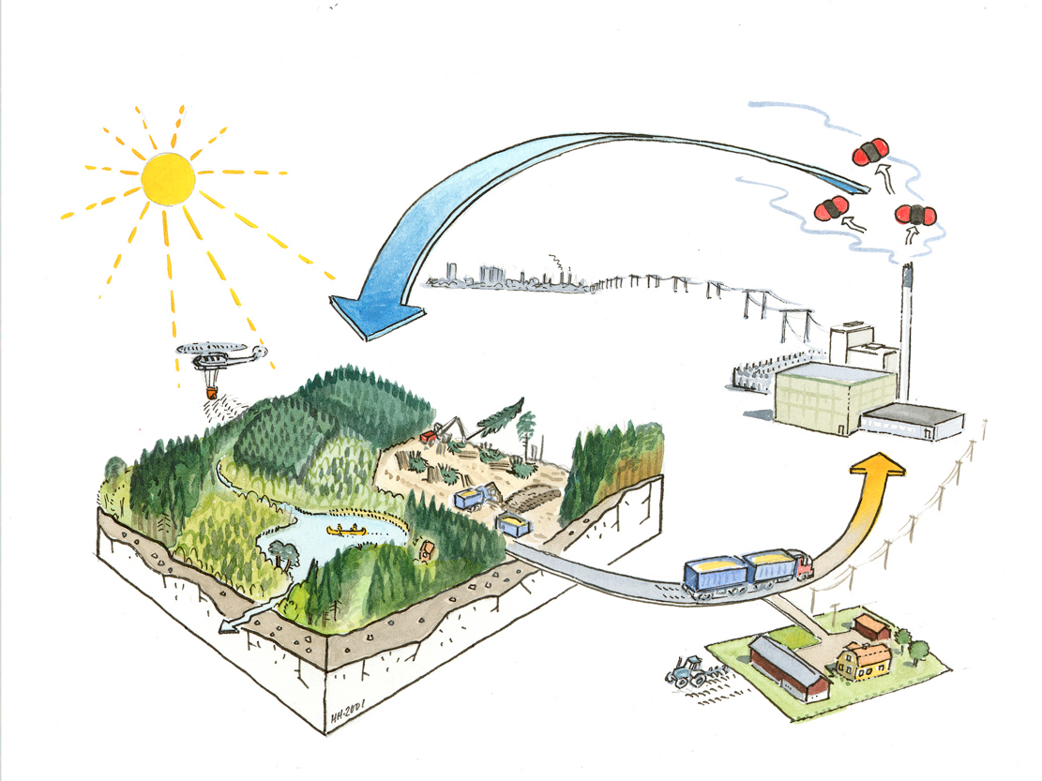
Critical Components of Sustainable Bioenergy Production Systems
Environmental Sustainability
Consumer Demand
Sustainable Production of Biobased Products
Sustainable Forest Operations
Manufacturing/
Energy Production
Product Delivery Logistics
Rural Economic Development
Martin Holmer, 2001
IEA Bioenergy Task 31

Slide 10
Our Watersheds and Forests are Threatened
Decades of fire suppression has left our forests vulnerable to the impacts of disease, drought and catastrophic wildfire.
NM forests provide drinking water for over 1,000,000 people in the state.
Landscape scale restoration is needed to ensure water security.

Slide 11
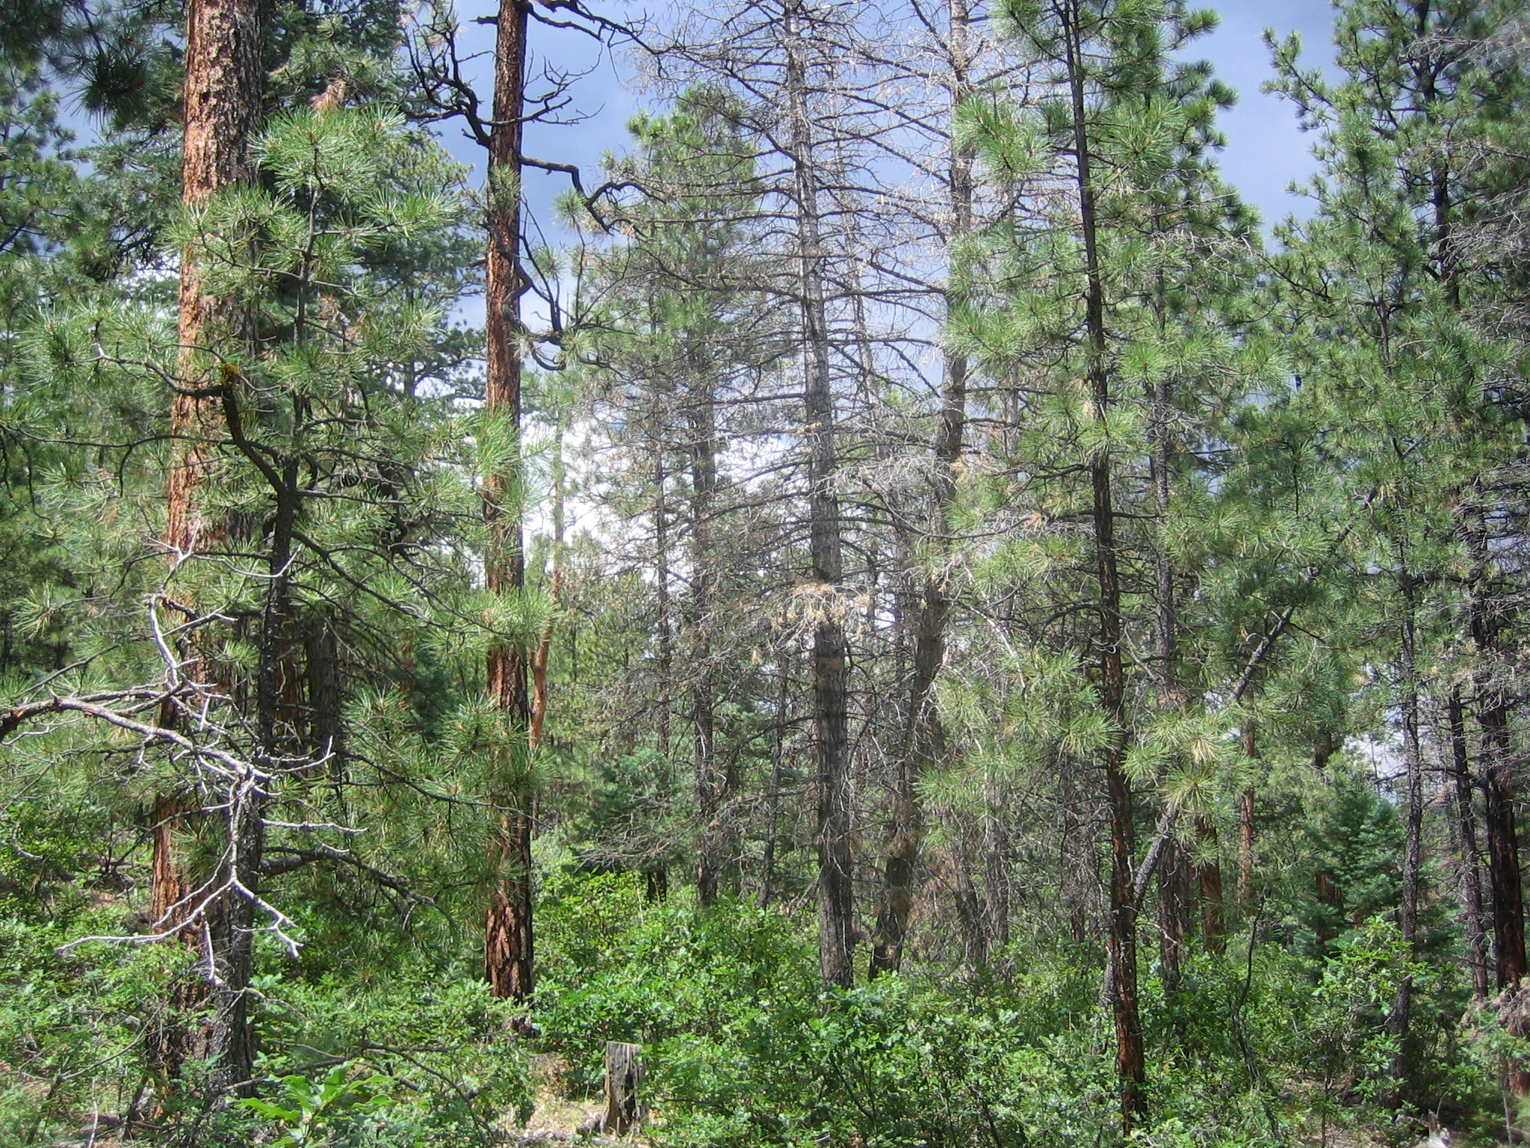
TOO MUCH FUEL

Slide 12
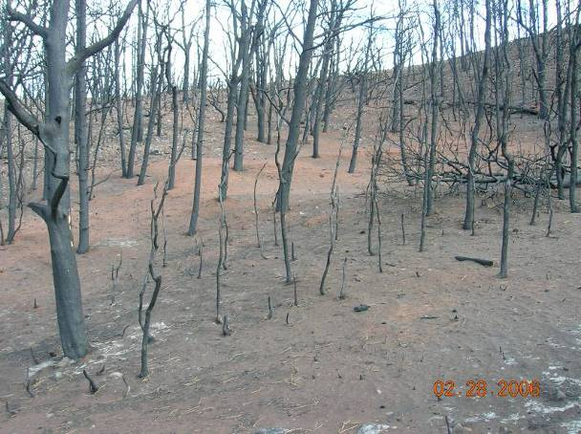
Intense Fires Destroy
Soils and Watersheds

Slide 13
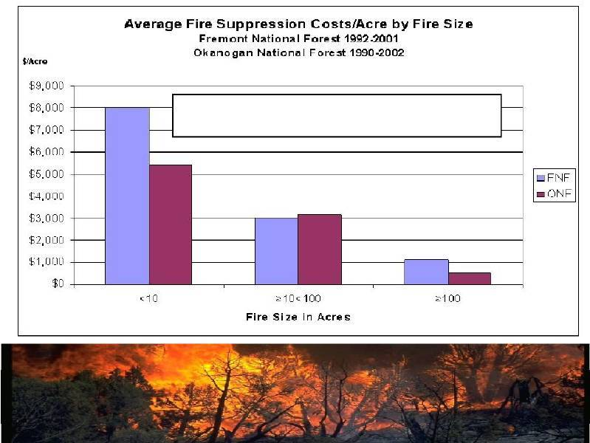
Average = $1172/Acre
Fire fighting is expensive and dangerous

Slide 14
TreatmentBenefits | PresentValueperacre
 | HighRisk | ModerateRisk
Firefighting costs avoided | $481 | $231
Fatalities avoided | $10 | $5
Facility losses avoided | $150 | $72
Timber losses avoided | $772 | $371
Regeneration and rehabilitation costs avoided | $120 | $58
Community value of fire risk reduction | $63 | $63
Regional economic benefits | $386 | $386
TotalBenefits | $1,982+ | $1,186+
Treatment costs
Operational costs | ($374) | ($374)
Forest Service contract preparation costs | ($206) | ($206)
Total Costs | ($580) | ($580)

Slide 15
40% of New Mexican Forests Need Thinning
2,768,300 Acres are in current need of thinning.
138,415 acres need to be thinned and burned each year to treat the entire region in 20 years.

Slide 16
New Mexico Water Relies on
Our Forests
Higher Elevations get more Precipitation
Winter Snowpacks feed the Aquifers
Catastrophic Wild Fires lead to Floods
Without the Forests we lose our towns

Slide 17
Numerous Obstacles Inhibit Forest Restoration
Significant portion of forests are made up of small diameter material which traditionally has little value.
Forest thinning projects often cost over $1,000 per acre.
Limited sawmill activity compared to previous decades

Slide 18
Changing the Economics of Forest Restoration
Efforts need to be made to provide a value added use for small diameter forest materials.
Possibilities Include:
District Heating
Biomass Energy
Traditional Wood Products
Bio-chemicals and Bio-based Products

Slide 19
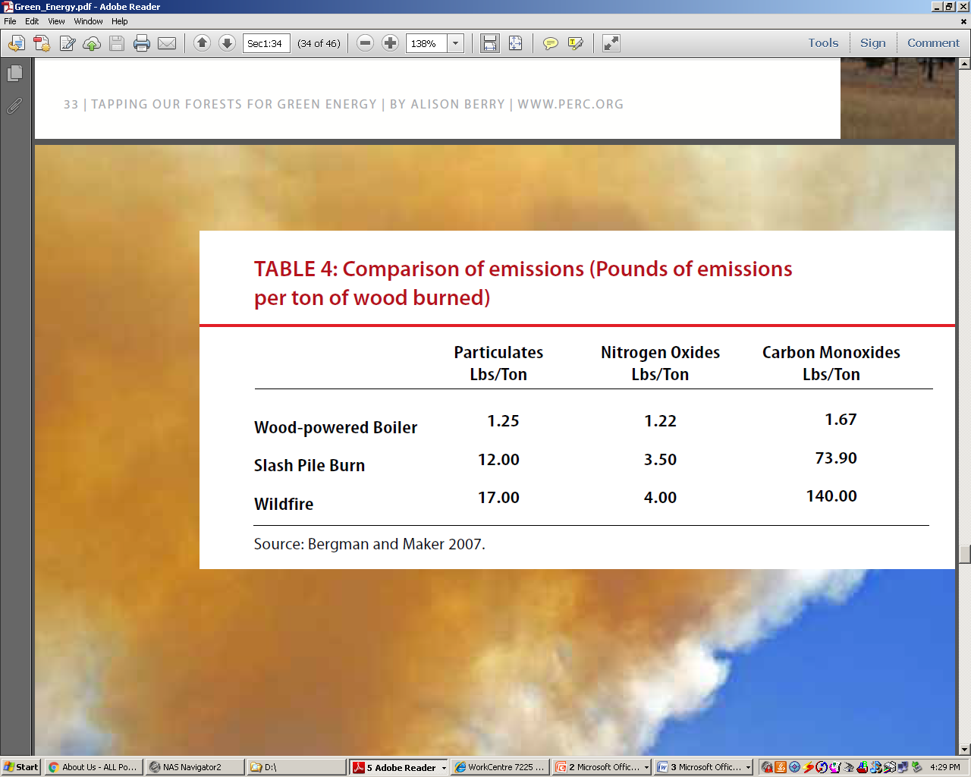
Wood Boilers Reduce Emissions

Slide 20
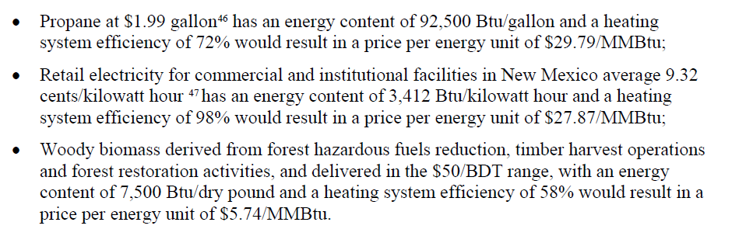
Comparative Energy Costs

Slide 21
The Use of Local Woody Biomass Provide Many Benefits
Cost savings vs Fossil Fuels
Creates local jobs and keeps $$ local
Supports the Restoration of Forests and creating Fire Adapted Communities
Provides the opportunity for hands on training in Biomass Energy use
Ties to Forestry and Ecology Programs

Slide 22
Bioenergy: leading renewable energy source used in Europe

Slide 23
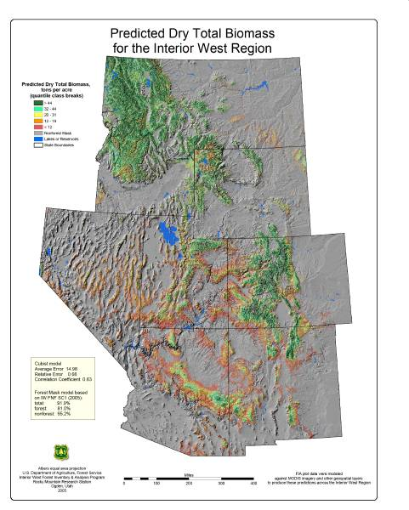
Biomass isn’t available everywhere and transportation costs affects its price

Slide 24
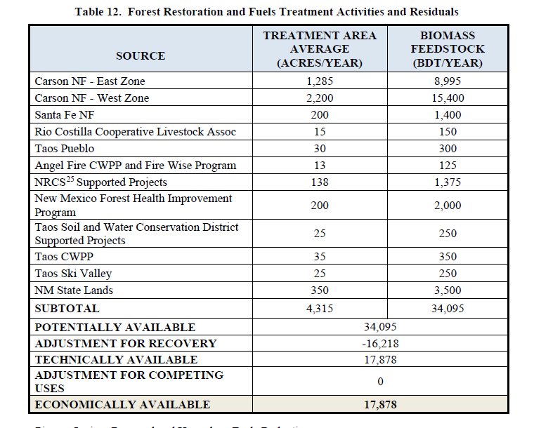
Biomass Fuel is Available
Group Selection/ Individual Tree Selection/Thin From Below/Stand Improvement Thinning/Mastication/ Broadcast Burning/Jackpot Burning/Pile Burning
Thin from Below/Stand Improvement Thinning/Personal Use/Broadcast Burning/Jackpot Burning/Pile Burning
Fuelbreak/Stand Improvement Thinning/Personal Use/Mastication/ Broadcast Burning/Jackpot Burning/Pile Burning
Mogote Fuelbreak
Aspen Regeneration Treatments (Patch-cuts/Group Selection/Thin from Below/Stand Improvement Thinning/Mastication/ Personal Use/Broadcast Burning/Jackpot Burning/Pile Burning
Meadow Restoration/Stand Improvement Thinning/Personal Use/Broadcast Burn/Jackpot Burn

Slide 25
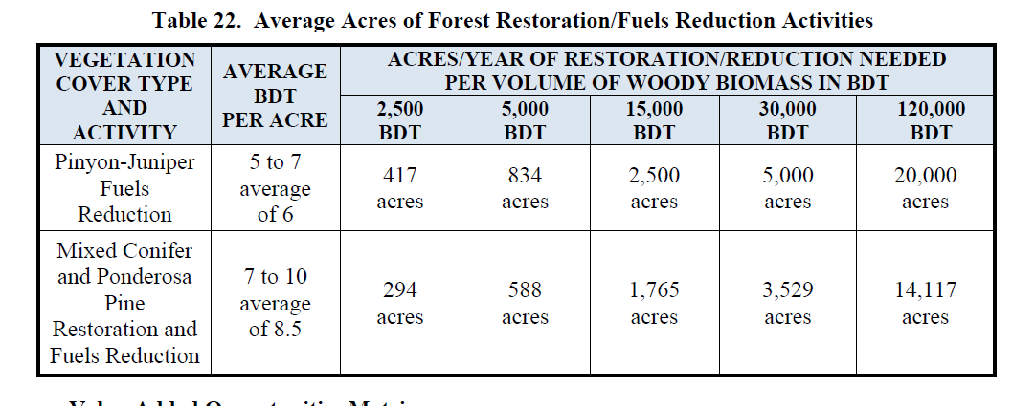
Thinning Acres for Fuel Amounts

Slide 26
Biomass Utilization Creates Sustainable Employment
Unlike Wind and Solar, the jobs don’t end once the systems are installed
When landscape thinning done over a 20 year period ia complete, new 20 year old growth needs to be thinned again
Biomass can also be used as feedstocks for replacing petrochemicals
Money spent on biomass fuels stay local creating local jobs and benefits for small towns

Slide 27
Mechanized Forestry
Modern Wood Harvesting Equipment
  Keeps Workers Safe
  Minimizes Soil Disturbance
  High Cost, but High Production
  Can Run at Night and in Winter
  Is Effective in Fighting Wild fires

Slide 28
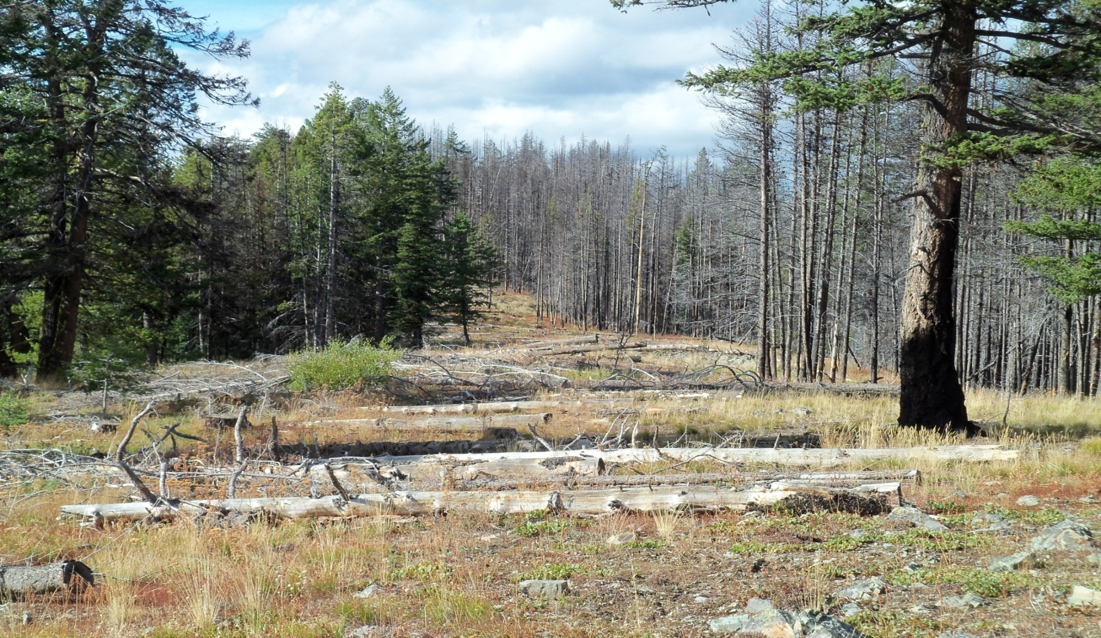
Example of mechanically built line, 50 feet wide. Fired out on right. Logs placed in line for rehab

Slide 29
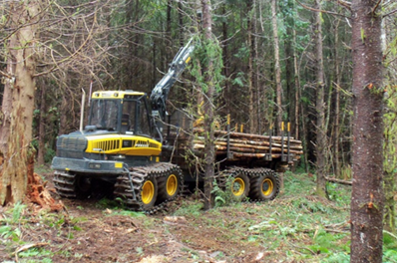
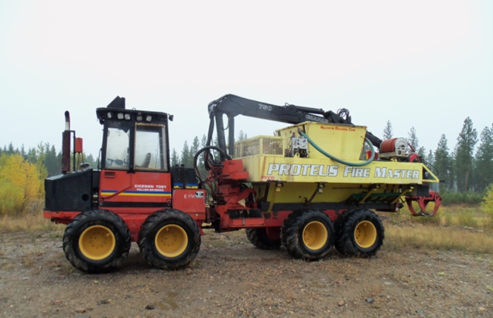
Machine Description-Skigines
Skidgines are comprised of two types of log moving machines
Forwarders and skidders
These machines have been modified to haul water and function as skidgines.
Type 1 skidgines are often log forwarders with large capacity tanks on them, generally from 1,200 to 3,000 gallons.
Forwarders are designed to carry logs free of the ground. Tanks are mounted where the logs would normally be placed
Forwarder
Type 1 Skidgine

Slide 30
Comparison of line construction methods
1 mile of line, 50 feet cleared of timber
2 feet to mineral soil
Crews
$10,000/shift x10 shifts = $100,000
Trees cut, bucked, carried by hand and piled in the green
Creates a large jackpot of fuel
2 feet to mineral soil, minimal rehab
Significant exposure from falling timber and hazard trees
Feller-Buncher, Tracked Skidder
$5,200 /Shift x 1 shift = $5,200
Trees cut and removed or some retained for rehab.
Minimal soil disturbance, 2 feet to mineral soil
Minimal rehab
No manual falling
Hazard trees cut mechanically
Creates safe work area for crews

Slide 31
Safety Advantages of Mechanization
Mechanization offers tremendous safety advantages over manual methods
Operators are all protected in an OSHA approved cab
It is about impossible to be struck by a tree or any other object inside a cab
As a wise logger once told me,
“The nice thing about equipment is ain’t nothing that can go wrong that a whole bunch of money can’t fix”
“But money can’t always fix a person”

Slide 32
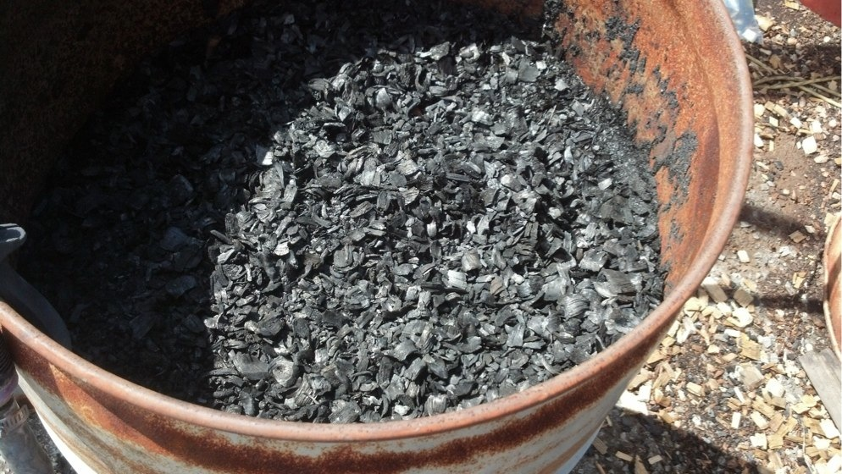
Biochar
Made from pine chips from forest restoration thinning
Can be made from any biomass, especially when pelletized
Certified by Sandia Labs to meet IBI standards

Slide 33
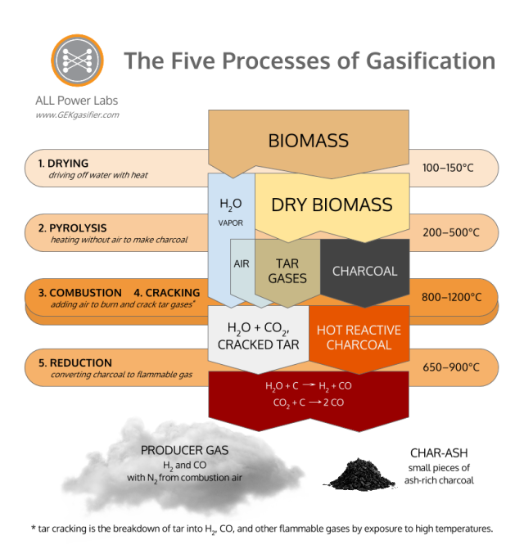

Slide 34
Biochar Energy is
Carbon Negative by Sequestering Carbon
“A pound of woody biomass can produce a half pound of biochar and 60,000 BTUs of thermal energy.
If biochar goes into the soil, for every pound of biomass used, 3.8 pounds of carbon dioxide will be removed from the atmosphere.”

Slide 35
Additional benefits of amending soil with biochar,
(1) increasing soil capacity to sorb plant nutrients thereby reducing nutrient loss to leaching ;
(2) decreasing soil bulk density resulting in less-compacted soil conditions favorable for root growth and water permeability;
(3) increasing soil cation exchange capacity;
(4) increasing soil microbial activity and diversity;
(5) increasing plant available water retention;
(6) providing protection against particular foliar and soil-borne diseases;
(7) increasing crop yields

Slide 36
A System Designed for Rural Communities
Biomass Energy uses almost any kind and quality of biomass
Facilitates niche business development
Mobile unit makes biochar and pellets
Building heater units make biochar and heat
Small units for cooking, water heating, space heating
Developed to utilize slash and waste biomass, complementing other wood products for highest value-adding
Gila WoodNet
7

Slide 37
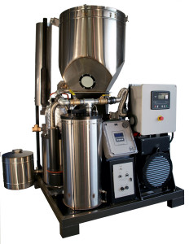
10 KW Biochar Electrical Generator
Output 53 megawatt hours per year of electricity
Consume 63 metric tons per year (tonnes/yr) of biomass
Sequester 3 tonnes carbon/yr or 11 tonnes CO2/yr
Offset from 15-93 tonnes CO2e/yr* compared to use of fossil fuel for electrical generation.
Offset rises to 28-211 tonnes CO2e/yr when including combined heat and power (CHP) option compared to fossil fuel for combined electrical and heat generation (assuming 68% total system efficiency)

Slide 38
Sandoval County
Biomass Utilization Feasibility Study
Completed December 31,2019

Slide 39
History
In 2017 Sandoval County was awarded a U.S. Forest Service wood innovations grant to identify viable biomass utilization processes and products and develop a wood products industry within the county.
The Sandoval County Biomass Utilization Feasibility Study addresses one of the major economic impediments to northern New Mexico’s forest restoration projects: how to convert low value/no value woody biomass from a waste that carries disposal costs, to a feedstock used to produce a marketable product(s).

Slide 40
Project Goals
Economic Development – create 900 new jobs in urban and rural areas throughout the region
Community Resilience – Promote water security through active watershed management
Forest Health – accelerate the reduction of hazardous fuels on 437,500 acres of forested lands within a 75-mi radius of the County. (Potential expansion outside 75-mi boundary with subsidy)

Slide 41
Tasks
Activity 1: Convene Regional Biomass Working Group
Activity 2: Evaluate Feedstock, Analyze Demand and Market Value for Wood Products
Activity 3: Pilot Manufacturing Capacity, Market Demand and Value for Local Wood Products
Activity 4: Identify and Quantify Revenue-Generating Co-Benefits from Wood Products Manufacturing
Activity 5: Perform an Economic ROI Analysis of the Most Promising Manufacturing Operations

Slide 42
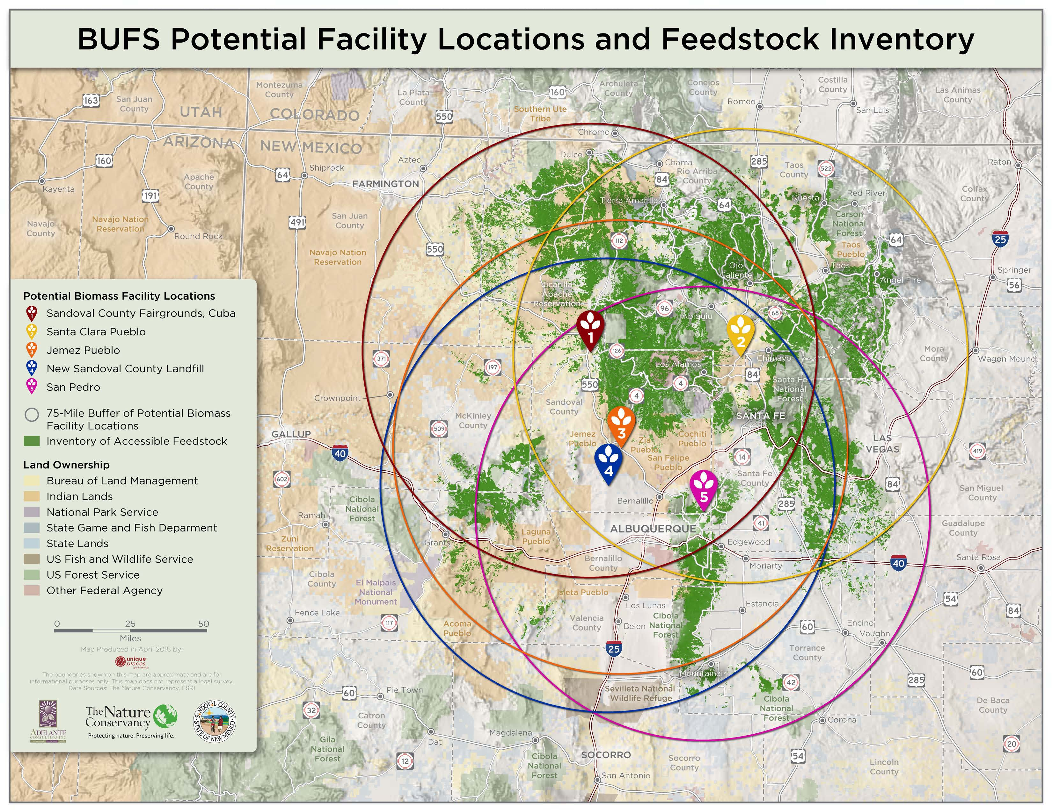

Slide 43
Feedstock Analysis
Completed as part of In-Kind contribution from the Nature Conservancy
Utilized the Nature Conservancy forest inventory data and forest service thinning estimations.
Site Location | Low-Funding Scenario (1,429 treated ac/yr) (BDT) | Avg-Funding Scenario (4,286 treated ac/yr) (BDT) | Hi-Funding Scenario (8,571 treated ac/yr) (BDT)
Cuba Fair Grounds | 7,827 | 34,714 | 69,428
County Land Fill | 7,064 | 56,374 | 112,738
Santa Clara Pueblo | 8,236 | 43,784 | 87,567
San Pedro | 6,398 | 58,641 | 117,281
Jemez Pueblo* | 6,500 | 60,000 | 120,000
* Estimated

Slide 44
Utility Analysis
Estimated water, electricity and natural gas hookup costs
Cuba region and Sandoval County Landfill were identified as having the lowest utility hookup costs.
Servicing the San Pedro region is cost prohibitive.
Property | Property Ownership | Distance to Natural Gas Connection | Distance to 345 KV Electrical Connection | Distance to 115 KV Electrical Connection | Within Designated Economic Opportunity Zone | Water Accessibility
Cuba Fair Grounds | Sandoval County | 2 Miles | 20 Miles | 0.1 Miles | No | 2 Miles
County Land Fill | Sandoval County | 0.1 Miles | 0.1 Miles | 15 Miles | No | 0.1 Miles
Santa Clara Pueblo | U.S. Department of Interior in trust for Santa Clara Pueblo | 0.2 Miles | 31 Miles | 0.3 Miles | No | 0.2 Miles
San Pedro | Private | 16 Miles | 6 Miles | 6 Miles | No | 16 Miles
Jemez Pueblo | Jemez Pueblo (fee simple) | 1 Mile | 9 Miles | 1 Mile | No | 1 Mile

Slide 45
Transportation Cost Analysis
Estimated collection, processing and transportation costs utilizing the Forest Service Forest Residues Transportation Costing Model
The Cuba and Jemez Pueblo regions were identified as having the lowest transportation costs
Site Location | Collection, Processing and Transport Dirty Chip ($/BDT) | Collection, Processing and Transport Small-diameter wood ($/BDT)
Cuba Fair Grounds | $48.06 | $42.54
County Land Fill | $54.24 | $48.57
Santa Clara Pueblo | $49.68 | $43.89
San Pedro | $51.80 | $45.95
Jemez Pueblo | $48.26 | $43.15

Slide 46
Criteria for Eliminating Biomass Processes/Products
Competes With Established Market
Wood Pellets
Vigas
Compost
Insufficient Demand
Decorative Bark/Chip
Shavings
Animal Bedding
Furniture
Chip for Paper
Filtration Media
Essential Oils
Pellets for WPC
Biochar
Cost/Feedstock Constraints
Renewable Chemicals
Biofuels
Biochar and bio-based products were identified as having the greatest potential to be manufactured and successfully marketed

Slide 47
Northern NM College El rito Campus
Biomass Heating and Biochar Production
A 2019 Collaborative Forest Restoration Project
by SW Energy Integrators and the Trollworlks
Installation will begin Spring 2019

Slide 48
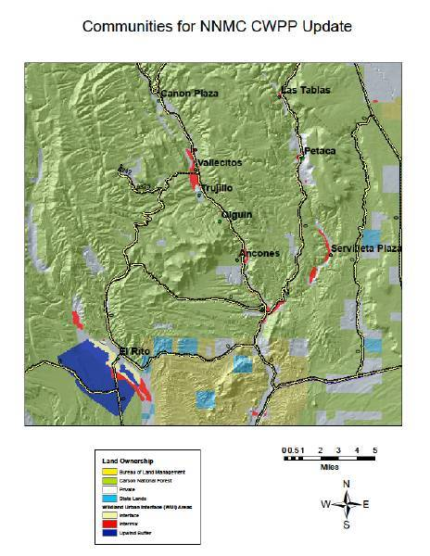
El Rito is Surrounded by Forests
The NEPA process is complete for the 17,000 acre Lower El Rito Canyon Wildland Urban Interface

Slide 49
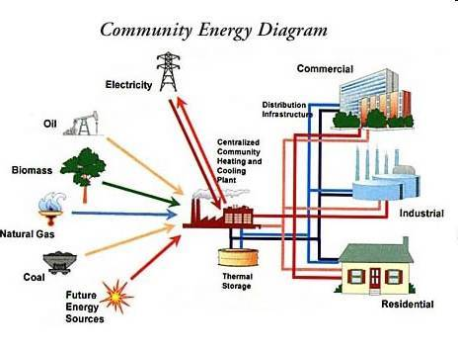
District Heating Enables a Variety of Energy Sources to Be Used
Notes:
49

Slide 50
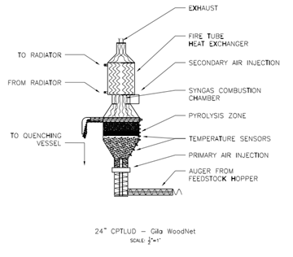
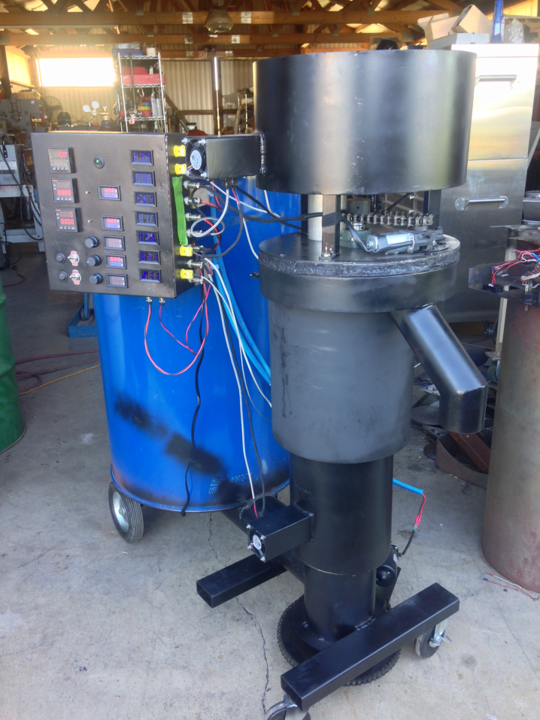
Modular Compact Design
Biochar System

Slide 51
ARRA Heating Upgrade Prepared the El Rito Campus for Biomass Use
The $495,500 American Reinvestment and Recovery Act project was completed in July 2011
The main buildings were connected with underground insulated pipe to form a district heating system
In 2010 the EPA announced that emission standards were going to be revised for all boilers no matter what size or fuel,
Without standards, compliance was impossible
3 Years later the new standards exempted boilers under 10 Million BTUS per hour
The emissions from the proposed biomass boiler would have been lower than the new standards

Slide 52
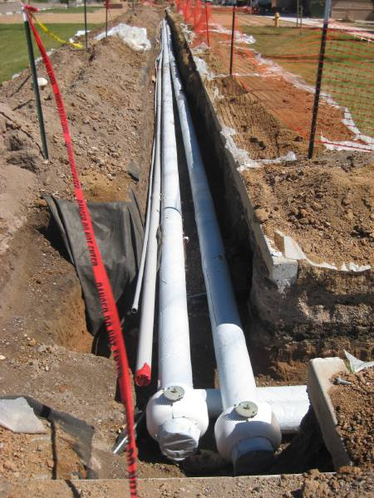

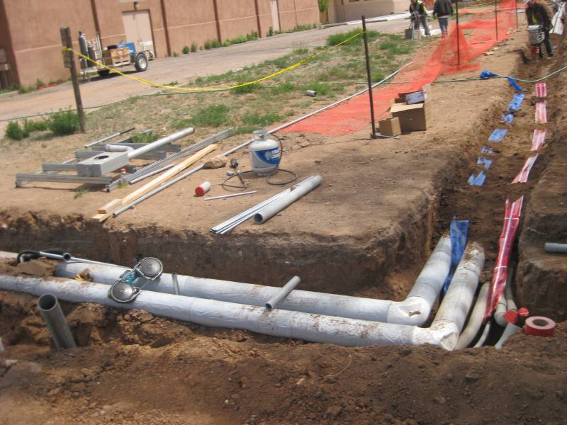
A District Heating System Shares Resources
Buried pipes connect the buildings
Hot water is distributed throughout the systems
Heat is provided by the least cost boilers first
Reliability is gained from having redundant heating sources
District heating allows the addition of renewable sources of energy
Notes:
52

Slide 53
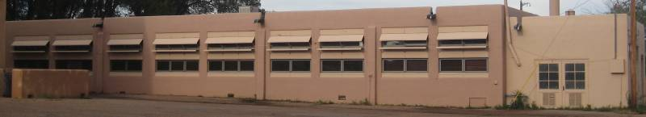
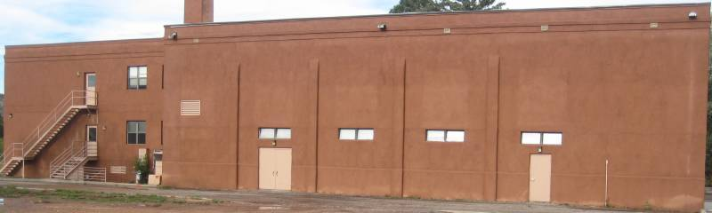
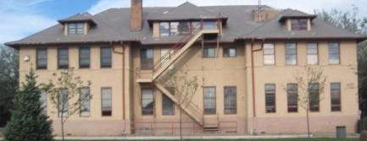
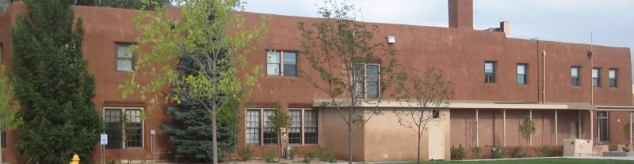

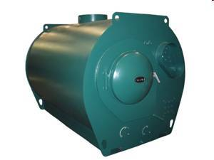
The boilers in each building are connected to the district heating system
Jaramillo Hall
North Dorm
Administration
South Dorm
Garn Boiler
Heat delivered through the district heating system to thermal ports at each building.
Each boiler can add heat as needed

Slide 54
Community District Heating
Several Community Service Buildings are near the NNMC El Rito campus
Could share heat from an intermediate scale CHP
  Las Clinicas del Norte
  El Rito Elementary School
  Rio Arriba County Senior Center
  El Rito Volunteer Fire Department
  US Post Office
Connected by well insulated buried pipes to conduct heat
Networked Thermal Instrumentation and Controls
Microgrid balancing of loads
Low cost heat for the community based on forest restoration

Slide 55
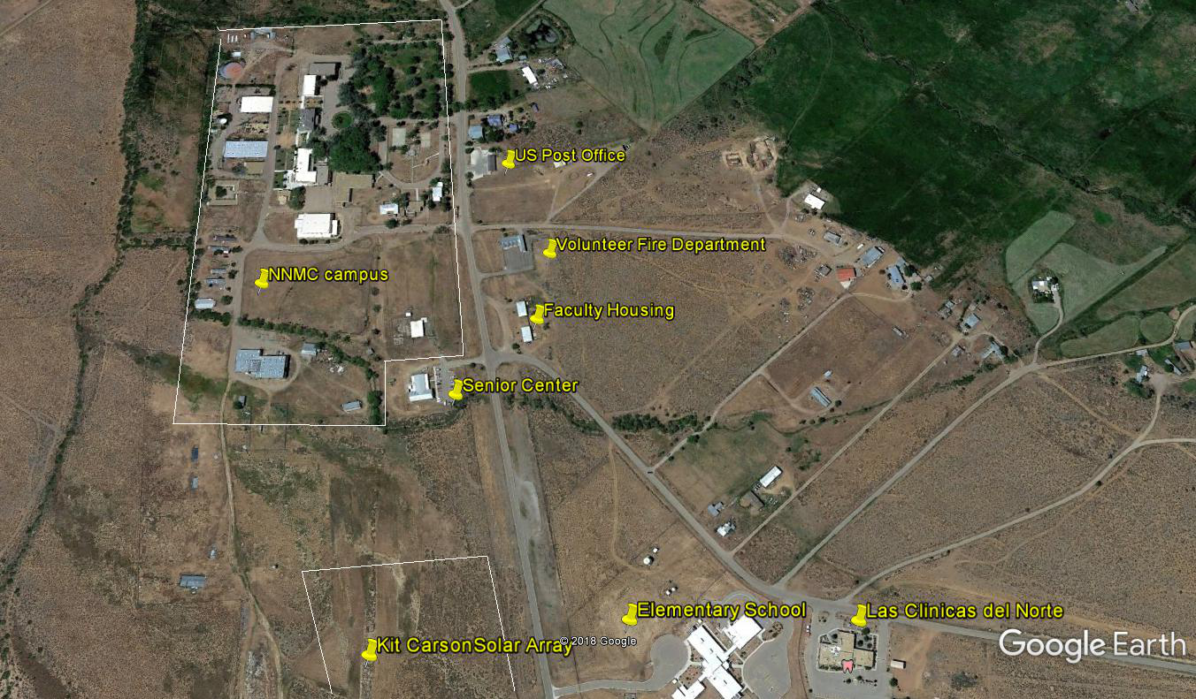
Potential
El Rito Community
District Heating System
And Microgrid

Slide 56
Multiple Benefits
Helps finance Forest Restoration by giving value to small diameter fuels
Provides low cost heat and power
Complements Solar by providing heat and power when the sun doesn’t shine
Creates a source of continuous employment
Keeps dollars local
Reduces carbon emissions versus open burning

